Slide 1
Temporal graph networks
By Akiva Block and Adi Weinberger

Slide 2
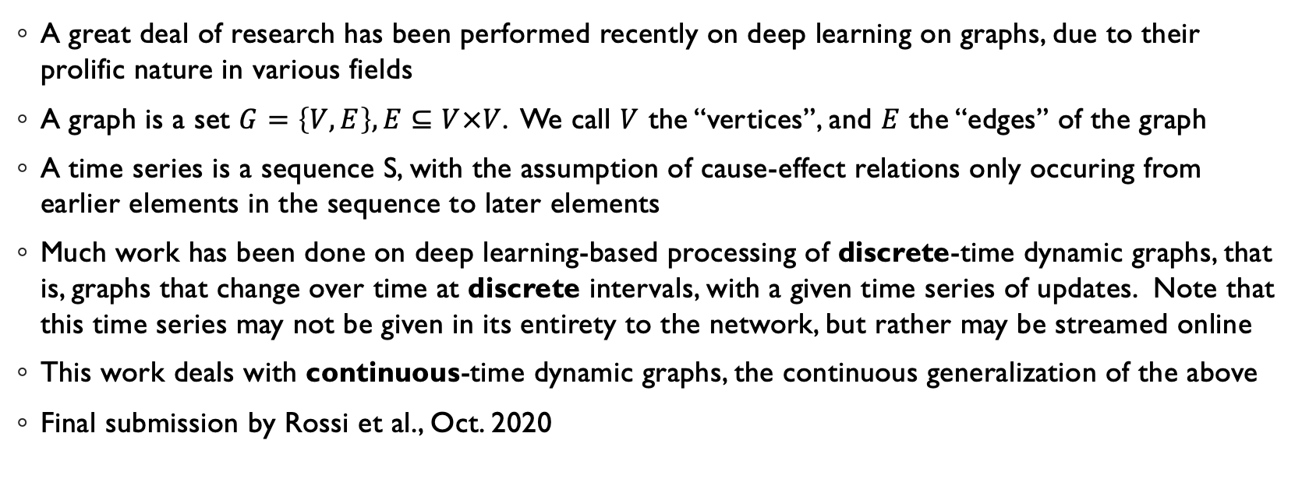
Introduction
A great deal of research has been performed recently on deep learning on graphs, due to their prolific nature in various fields
A graph is a set $G=\left\{V,E\right\},E⊆V×V$. We call $V$ the “vertices”, and $E$ the “edges” of the graph
A time series is a sequence S, with the assumption of cause-effect relations only occuring from earlier elements in the sequence to later elements
Much work has been done on deep learning-based processing of discrete-time dynamic graphs, that is, graphs that change over time at discrete intervals, with a given time series of updates. Note that this time series may not be given in its entirety to the network, but rather may be streamed online
This work deals with continuous-time dynamic graphs, the continuous generalization of the above
Final submission by Rossi et al., Oct. 2020

Slide 3
Setting
We assume we are given an initial graph and a series of updates performed on the graphs (either on the vertices or the edges, either existing or new, or deletions of existing vertices/edges), along with the times of their occurences
It is noteworthy that the development of the graph over time may have significance, so that it is important to consider past updates when considering the current state of the graph

Slide 4
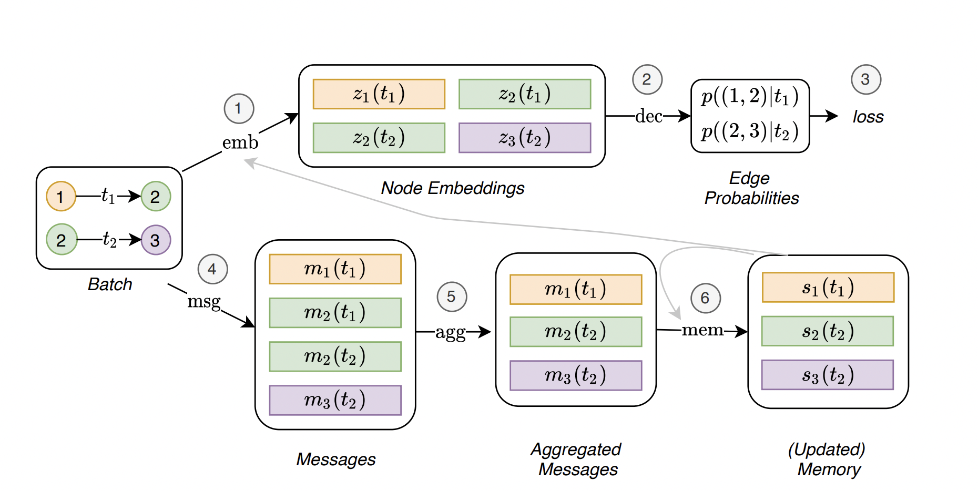
TGN (=Temporal Graph Network)
The paper proposes a general framework with which to process these temporal graphs

Slide 5
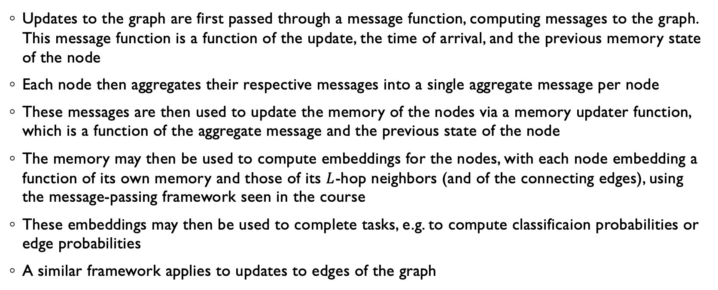
Breakdown of TGN (simplified)
Updates to the graph are first passed through a message function, computing messages to the graph. This message function is a function of the update, the time of arrival, and the previous memory state of the node
Each node then aggregates their respective messages into a single aggregate message per node
These messages are then used to update the memory of the nodes via a memory updater function, which is a function of the aggregate message and the previous state of the node
The memory may then be used to compute embeddings for the nodes, with each node embedding a function of its own memory and those of its $L$-hop neighbors (and of the connecting edges), using the message-passing framework seen in the course
These embeddings may then be used to complete tasks, e.g. to compute classificaion probabilities or edge probabilities
A similar framework applies to updates to edges of the graph

Slide 6
Training Memory Update Pipeline
In order to allow backpropagation from the loss to the memory update pipeline, we must compute the updates to the graph memory just before the loss is computed.
The paper proposes to do this by employing a raw message store, only sent through the memory update pipeline just in time for the loss to be computed.

Slide 7
Aggregations
The network calls for aggregation operations in 3 places: in the message aggregator, in the memory updater (computing updates to the node memories with input from the previous memories), and in the embedding module, aggregating aggregate messages and node memories to compute the node embeddings
The paper proposes using either summation aggreagtion or attention aggregation (just as we saw in the course) in the embedding module, and demonstrates superior performance in general of the attention aggregation, with the drawback of additional complexity and longer inference time
The paper proposes using either LSTM or GRU recurrent units to compute the memory updates
The paper proposes using either the mean message (the average of all the given messages) or the last message (simply eliminating all but the most recent message) for the message aggregator. Our contribution lies here, testing various alternatives to these rather basic-sounding aggregators.

Slide 8
Our Contribution: Proposed Aggregators
We experimented with a variety of aggregators in place of the paper’s proposed aggregators. The most successful candidates from the self-supervised edge-prediction task were also applied to the semi-supervised node classification task:
The aggregations proposed in the paper (average/most recent), as a baseline. We asserted that our performances matched those given in the paper
MLP (the “generic” solution), applied to the last few messages, message-element by message-element
A series of dilated convolutions over the time dimension, followed by a shallow MLP, inspired by the dilated convolution aggregator proposed in the prerequisite course (Deep Learning On Computational Accelerators)
GRU, a common sequence analysis tool in the modern literature

Slide 9
Our Contribution: Proposed Aggregators (continued)
An attention module, motivated by considering attention as a development to the sum aggregator in the paper, in which the sum becomes a weighted sum with weights learned by the network itself, adapting to the data
An MLP that takes the concatenation of the last few messages, designed to investigate the possible dependencies of the optimal aggregation on the content of the messages, but at the cost of multiplying the number of parameters in each layer of the network by the length of the messages
A combined RNN-Attention module, inspired by the recent forecasting work Temporal Fusion Transformer (TFT) by Lim et. al, (submitted to Elsevier 2020), in which the demonstrated in the ablation study that the single most influential component of their network was the combined GRU-Self Attention module, with performance hits of up to 20% upon ablation. An additional benefit to this module is its easy interpretability.

Slide 10
Results:
Aggregator | Edge prediction (average precision) |  | Node classification (AUC) | Median epoch time (seconds)
 | Transductive | Inductive |  | Edge pred. | Node class.
Mean message | 98.6% | 97.93% | - | 93 | -
Last message | 98.46% | 97.81% | 87.81% | 20 | -
Per-element MLP | 98.24% | 97.41% | - | 916 | -
Dilated convolutions | 98.17% | 97.32% | - | 1560 | -
GRU | 98.65% | 98.08% | 82.72% | 849 | 1897
Concatenated-messages MLP | 98.45% | 97.76% | - | 1338 | -
Self-attention | 98.57% | 97.96% | 89.1% | 2087 | 2946
GRU-attention hybrid | 98.51% | 97.86% | - | 2388 | -

Slide 11
Experiment details
The experiments were run with the same configurations as those given in the paper, with the following restrictions:
We experimented only on the Wikipedia dataset given in the paper, due to its smaller size, to cope with limited computational resources
We employed only the attention-based embedding module, due to its superior experimental performance and our primary concern with performance (and our lesser interest in inference time)
We present only the metrics presented in the paper for each problem set, to compare our results with those given in the paper
Our code was submitted to the course website alongside this report

Slide 12
Conclusion
Our experiments revealed that there was some room for improvement in the techniques proposed in the paper.
The paper’s aggregators were significantly faster than ours, however at a small cost in performance.
Our most successful edge prediction aggregator was the GRU, and our most successful node classification aggregator was self-attention. It is interesting to note that the performance of the GRU and self-attention combination did not match up to either module alone, however further experimentation with parameters may narrow the gap

Slide 13
Future Research
We propose experimenting with additional replacements to the other aggregators in the model
We propose using attention based on the node memory (in addition to self-attention) for the embedding step, due to an intuitive understanding that the “node itself may know best” what data will benefit its embedding.
Further expanding the previous proposition in the reverse direction, we also propose feeding data from the embeddings back into the node memory (thus adding a certain complex recurrent property to the model) to account for possible dependencies of the node memory on the data from neighboring nodes. Although the embedding is already dependent on neighboring nodes’ memories, this additional connection could add an indirect channel for data to propagate over time from node to node, to enable the network to contend with complexities developing over time in the graph data, as well as providing a shorter channel for the gradients to the model’s memory processing pipeline

